Slide 1
Square-Root Coprocessor
Reconfigurable Computing
A FPGA Based Square-Root Approximation Coprocessor
Paulo Vasconcelos 84987
Pedro Teixeira 84715

Slide 2
Theoretical Background

Slide 3
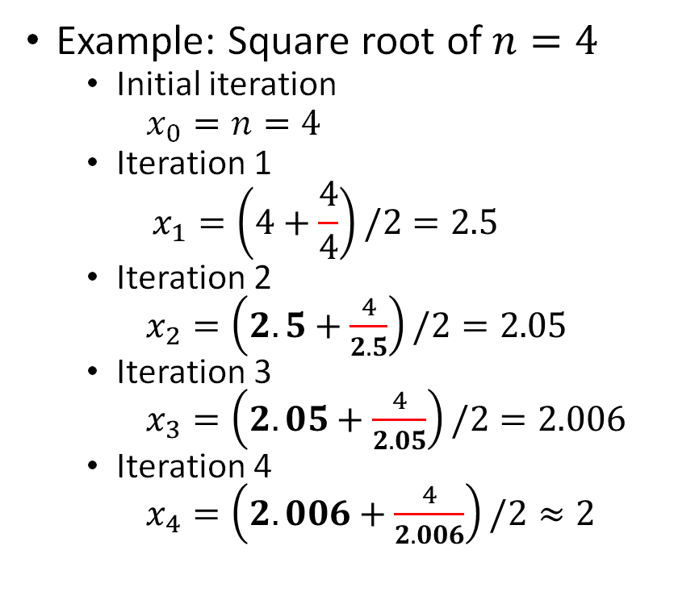
Theoretical Background (I/III)
Goal: create a coprocessor to compute square root of non-negative integers
First approach: Newton's method
Pros:
Would allow for a configurable approximation order of magnitude;
Recursive (easier to implement).
Cons:
Not exact result – even for square numbers;
Composed of "not so easy to implement in hardware" operations (division);
Problem with fractional values representation (floating vs fixed, single vs double precision).
Example: Square root of $n=4$
Initial iteration
$x_{0}=n=4$
Iteration 1
$$x_{1}=\left(4+\frac{4}{4}\right)/2=2.5$$
Iteration 2
$x_{2}=\left(2.5+\frac{4}{2.5}\right)/2=2.05$
Iteration 3
$x_{3}=\left(2.05+\frac{4}{2.05}\right)/2=2.006$
Iteration 4
$x_{4}=\left(2.006+\frac{4}{2.006}\right)/2≈2$

Slide 4
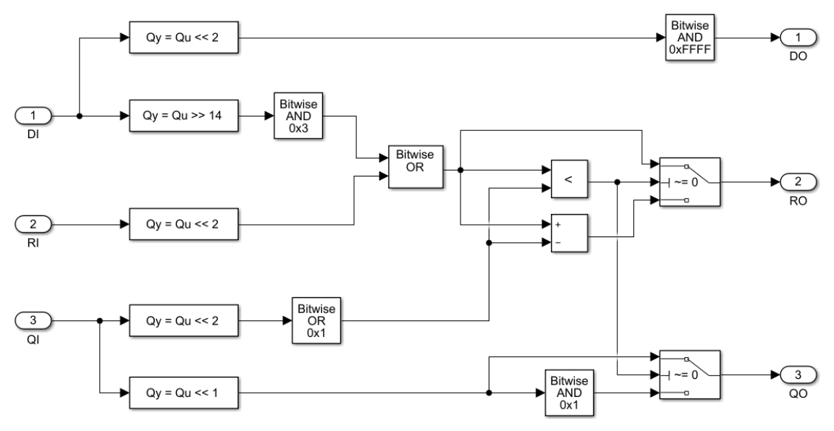
Theoretical Background (II/III)
Approach taken: Non-Restoring Algorithm
Pros:
Only integer values handled;
Allows for a configurable word size;
Mostly based on simple bitwise and shift operations;
Recursive (with word size / 2 iterations).
Cons:
Unable to provide exact value for square root of non-perfect squares.
Figure 1 – Non-Restoring Algorithm

Slide 5
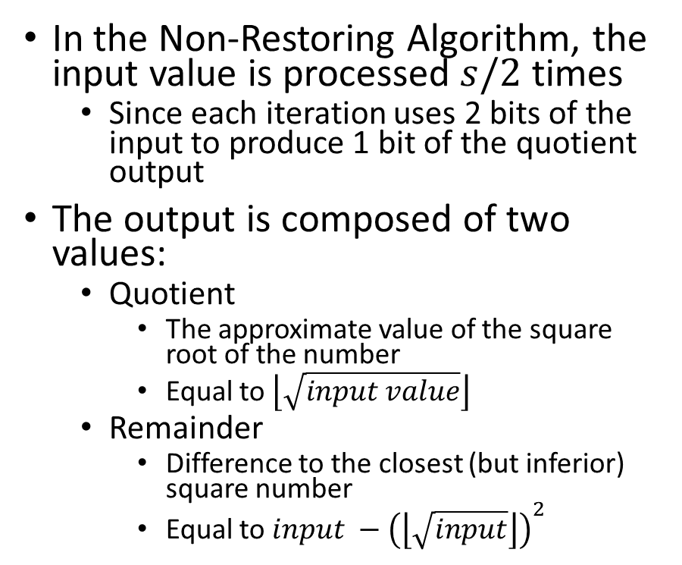
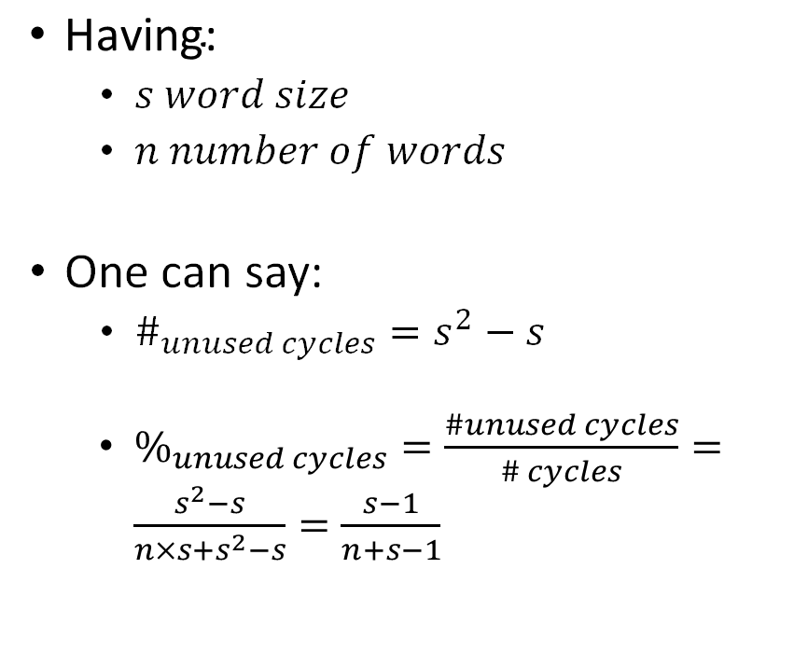
Theoretical Background (III/III)
In the Non-Restoring Algorithm, the input value is processed $s/2$ times
Since each iteration uses 2 bits of the input to produce 1 bit of the quotient output
The output is composed of two values:
Quotient
The approximate value of the square root of the number
Equal to $\left\lfloor \sqrt{input value}\right\rfloor$
Remainder
Difference to the closest (but inferior) square number
Equal to $input −{\left(\left\lfloor \sqrt{input}\right\rfloor \right)}^{2}$
$\text{Having}\text{: }$
$s word size$
$n number of words$
One can say:
$\#_{unused cycles}=s^{2}−s$
$\%_{unused cycles}=\frac{\#unused cycles}{\# cycles}=\frac{s^{2}−s}{n×s+s^{2}−s}=\frac{s−1}{n+s−1}$
Notes:
Detected 1 CUDA Capable device(s) Device 0: "GeForce GTX 1060 6GB" CUDA Driver Version / Runtime Version 10.1 / 10.1 CUDA Capability Major/Minor version number: 6.1 Total amount of global memory: 5.93 GBytes (6372196352 bytes) GPU Clock rate: 1785 MHz (1.78 GHz) Memory Clock rate: 4004 Mhz Memory Bus Width: 192-bit L2 Cache Size: 1572864 bytes Max Texture Dimension Size (x,y,z) 1D=(131072), 2D=(131072,65536), 3D=(16384,16384,16384) Max Layered Texture Size (dim) x layers 1D=(32768) x 2048, 2D=(32768,32768) x 2048 Total amount of constant memory: 65536 bytes Total amount of shared memory per block: 49152 bytes Total number of registers available per block: 65536 Warp size: 32 Maximum number of threads per multiprocessor: 2048 Maximum number of threads per block: 1024 Maximum sizes of each dimension of a block: 1024 x 1024 x 64 Maximum sizes of each dimension of a grid: 2147483647 x 65535 x 65535 Maximum memory pitch: 2147483647 bytes

Slide 6
Implemented Solution

Slide 7
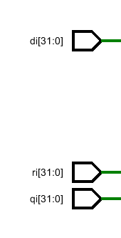


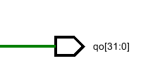


Basic Blocks & Architecture
Square Root Basic Block (SRBB)
Defined a basic block responsible for 1 iteration of the Non-restoring algorithm
Square Root Block
Defined a block responsible for replicating n/2 basic blocks and producing the results
Square Root Block
A set of n/2 basic blocks in a chain produces the final result
Used a for generate
Used registers for a pipelined solution, decreasing the worst negative slack
Inputs:
CLK: the clock
DATA_IN: the word
NEW_VALUE: signalize a new valid word is being processed
Outputs:
SQRT: approximation for the Square Root value
REMAINER: difference to the closest (but inferior) square number
IS_SQUARE_NUM: indicates if a number is a square number
DONE: indicates the output is valid
SquareRootBasicBlock $(n=32)$
CLK
SRB0
SRBB1
SQRT [31:0]
DATA_IN[31:0]
REMAINER [31:0]
…
SRBB n/2
IS_SQUARE_ROOT
NEW_VALUE
DONE
SquareRoot $(n=32)$

Slide 8
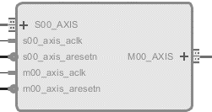
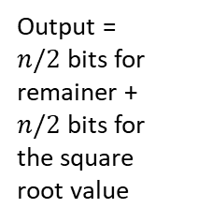
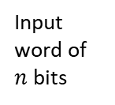
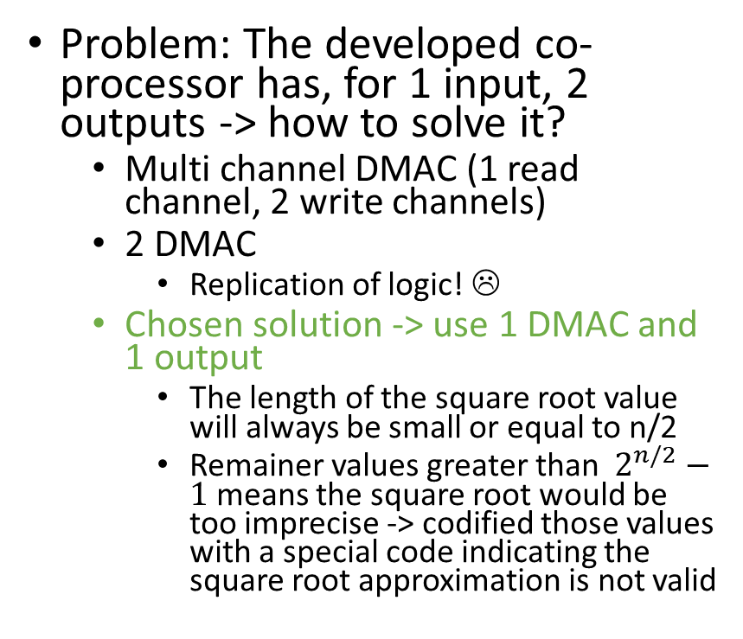
Connecting the Coprocessor to the Hardware platform
Used the standard hardware platform
Having in mind the possible usage scenarios, a DMA based solution was used to connect to platform
Avoiding the CPU to be responsible for each transfer between the memory and the peripheral
Used a dedicated DMA mode
The coprocessor has 2 main interfaces:
Problem: The developed co-processor has, for 1 input, 2 outputs -> how to solve it?
Multi channel DMAC (1 read channel, 2 write channels)
2 DMAC
Replication of logic! ☹
Chosen solution -> use 1 DMAC and 1 output
The length of the square root value will always be small or equal to n/2
Remainer values greater than $2^{n/2}−1$ means the square root would be too imprecise -> codified those values with a special code indicating the square root approximation is not valid
Input word of $n$ bits
Output = $n/2$bits for remainer + $n/2$bits for the square root value

Slide 9
Validating the solution

Slide 10
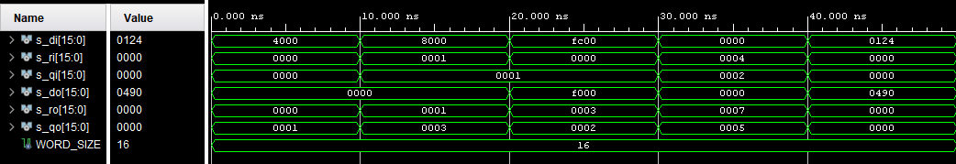
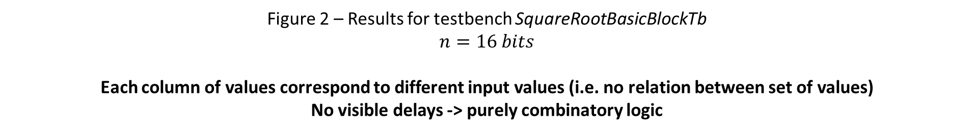
Validating the Square Root Basic Block (for one iteration of the non-restoring algorithm)
Value for an initial iteration of the algorithm
Values for a non initial iteration of the algorithm
Figure 2 – Results for testbench SquareRootBasicBlockTb
$$n=16 bits$$
Each column of values correspond to different input values (i.e. no relation between set of values) No visible delays -> purely combinatory logic

Slide 11
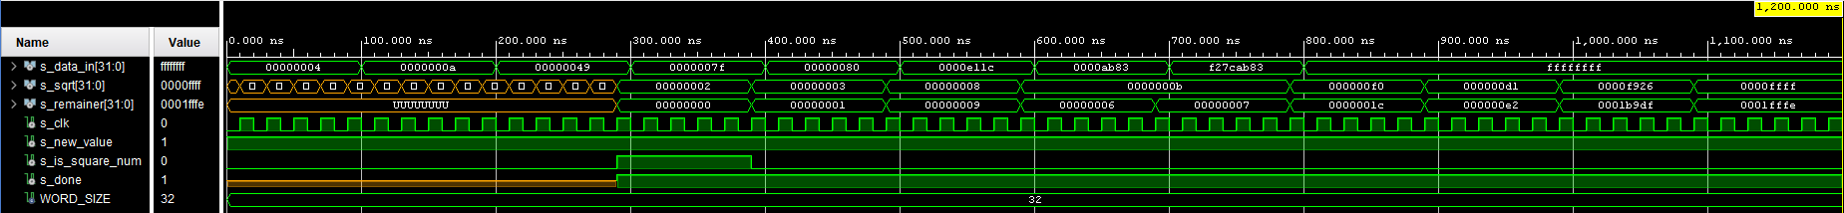
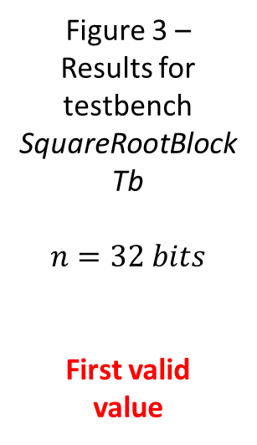
Validating the Square Root Block (for all the iterations of the non-restoring algorithm)
Figure 3 – Results for testbench SquareRootBlockTb
$$n=32 bits$$
First valid
value
Square Root Block is a synchronous block since it’s a pipelined set of Square Root Basic Blocks

Slide 12
Timing & Performance Analysis

Slide 13
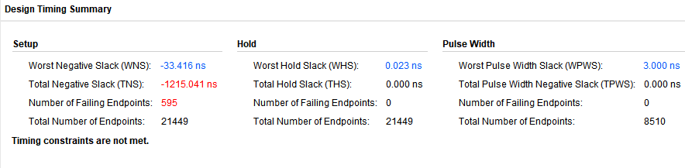
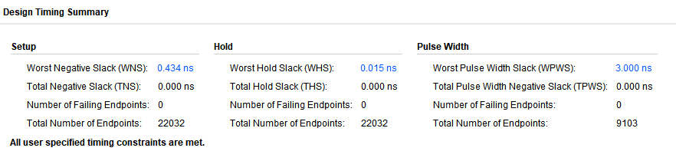
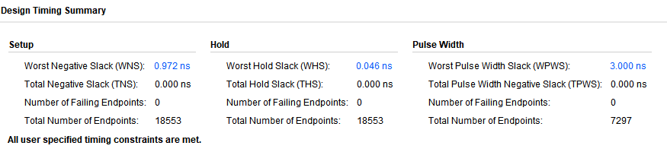

Timing Analysis
Initial timing analysis
Critical path within the coprocessor slave interface (where the square root is computed)
Final timing analysis
Solved by adding bank of registers between each iteration (each SquareRootBasicBlock) turning a chain of combinatory blocks into a pipeline
$$Improvement=\left|\frac{−33.416}{0.434}\right|≈77$$

Slide 14
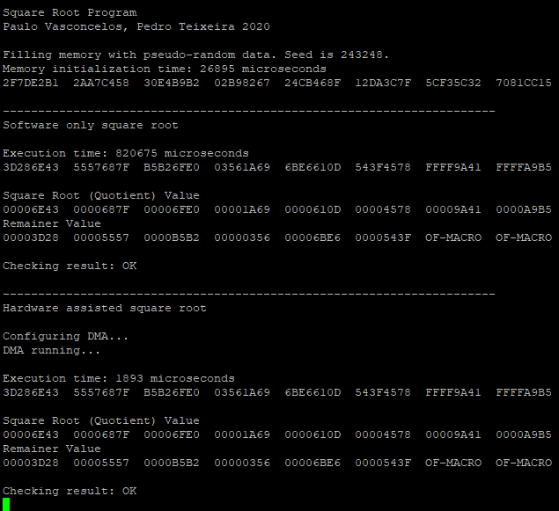
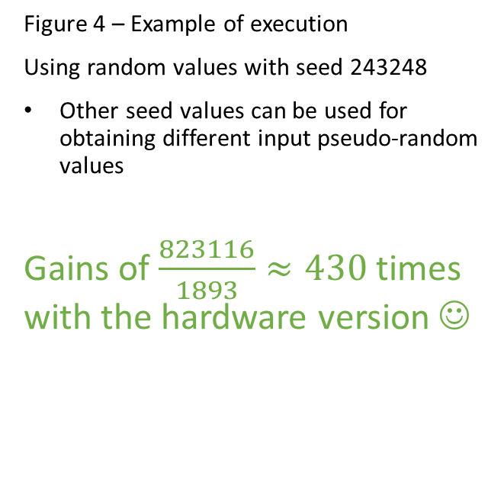
Performance Analysis
Figure 4 – Example of execution
Using random values with seed 243248
Other seed values can be used for obtaining different input pseudo-random values
Gains of $\frac{823116}{1893}≈430$ times with the hardware version ☺

